Slide 1
Recursion - III
Lecture-9
Advanced Problems on Recursion and Backtracking
Prateek Narang

Slide 2
Permutations of a String

Slide 3
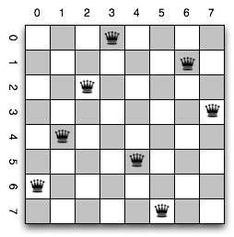
N-Queen Problem

Slide 4
Unique Permutations

Slide 5
SET Data Structure : STL

Slide 6
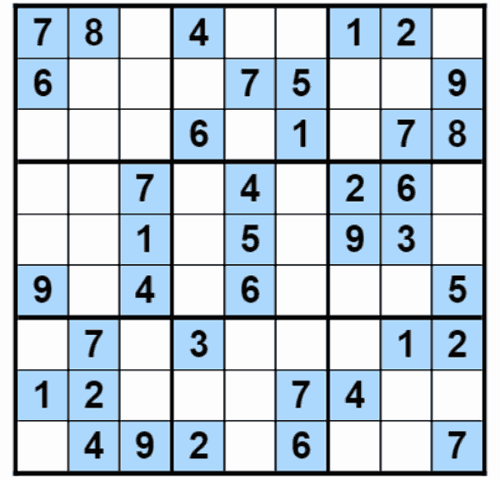
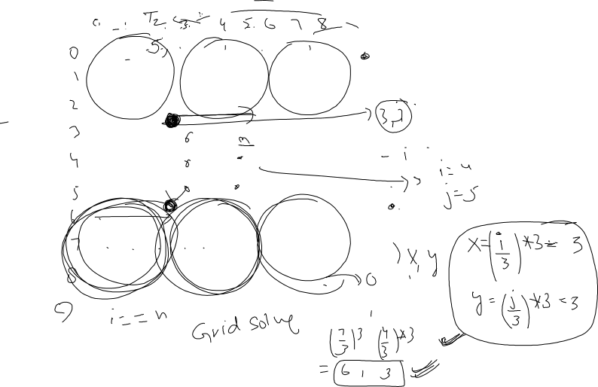
Sudoku Solver
Create a Sudoku Solver and Checker

Slide 7
Sample Input
int mat[9][9] =
{{5,3,0,0,7,0,0,0,0},
{6,0,0,1,9,5,0,0,0},
{0,9,8,0,0,0,0,6,0},
{8,0,0,0,6,0,0,0,3},
{4,0,0,8,0,3,0,0,1},
{7,0,0,0,2,0,0,0,6},
{0,6,0,0,0,0,2,8,0},
{0,0,0,4,1,9,0,0,5},
{0,0,0,0,8,0,0,7,9}};

Slide 8
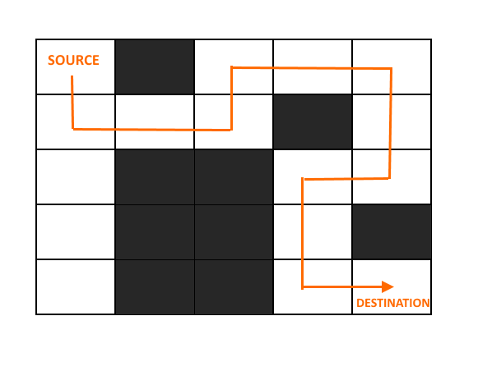
Rat in a Maze

Slide 9
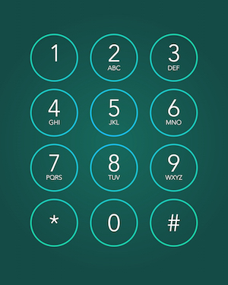
Phone Keypad

Slide 10

Optimal Game Strategy

